Slide 1
  Modeling Approaches
  Physical/chemical (fundamental, global)
    Model structure by theoretical analysis
      Material/energy balances
      Heat, mass, and momentum transfer
      Thermodynamics, chemical kinetics
      Physical property relationships
    Model complexity must be determined (assumptions)
    Can be computationally expensive (not real-time)
    May be expensive/time-consuming to obtain
    Good for extrapolation, scale-up
    Does not require experimental data to obtain (data required for validation and fitting)
Chapter 2

Slide 2
Black box (empirical)
  Large number of unknown parameters
  Can be obtained quickly (e.g., linear regression)
  Model structure is subjective
  Dangerous to extrapolate
Semi-empirical
  Compromise of first two approaches
  Model structure may be simpler
  Typically 2 to 10 physical parameters estimated
  (nonlinear regression)
  Good versatility, can be extrapolated
  Can be run in real-time
Chapter 2

Slide 3
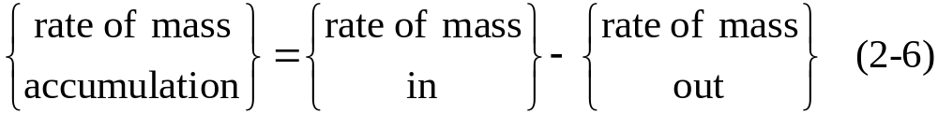
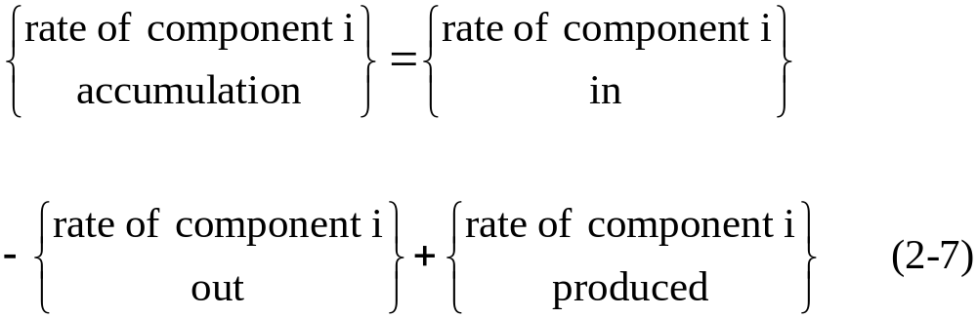
Conservation Laws
Theoretical models of chemical processes are based on conservation laws.
Conservation of Mass
Chapter 2
Conservation of Component i

Slide 4
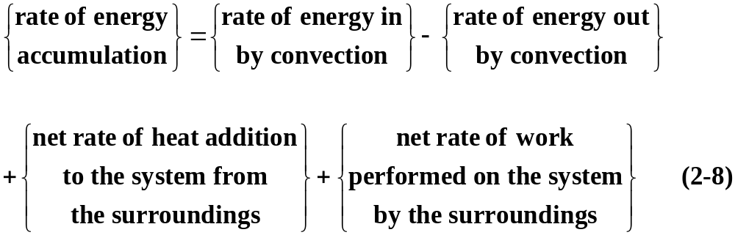
Conservation of Energy
The general law of energy conservation is also called the First Law of Thermodynamics. It can be expressed as:
Chapter 2
The total energy of a thermodynamic system, U_{tot}, is the sum of its internal energy, kinetic energy, and potential energy:

Slide 5
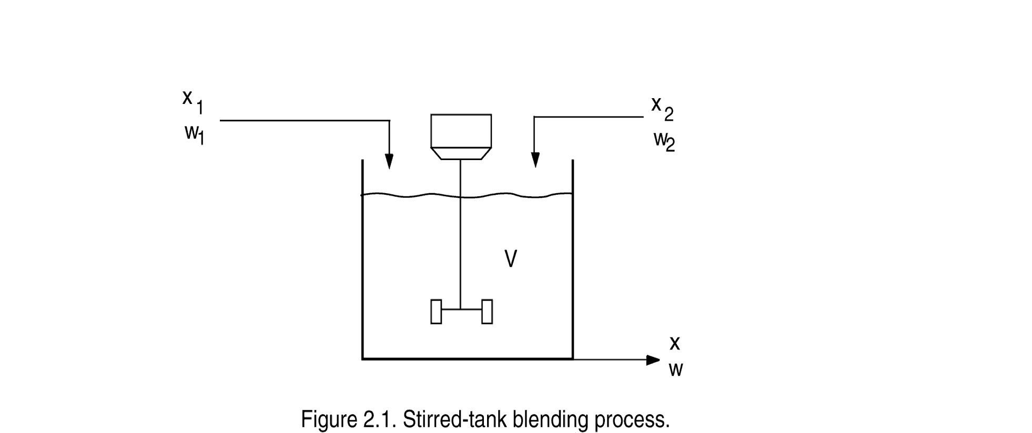
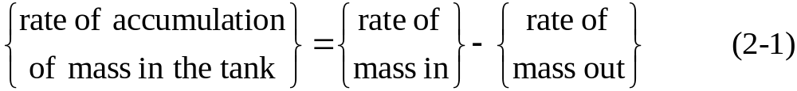
Development of Dynamic Models
Illustrative Example: A Blending Process
Chapter 2
An unsteady-state mass balance for the blending system:

Slide 6
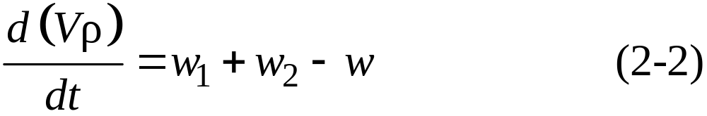
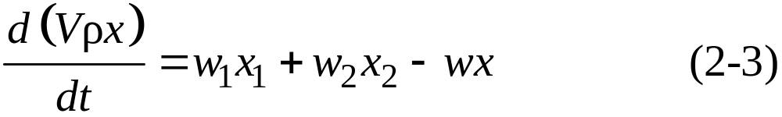
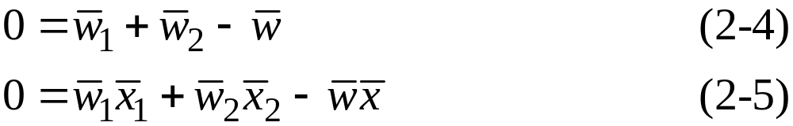
or
where w₁, w₂, and w are mass flow rates.
The unsteady-state component balance is:
Chapter 2
The corresponding steady-state model was derived in Ch. 1 (cf. Eqs. 1-1 and 1-2).

Slide 7

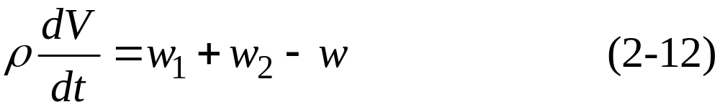
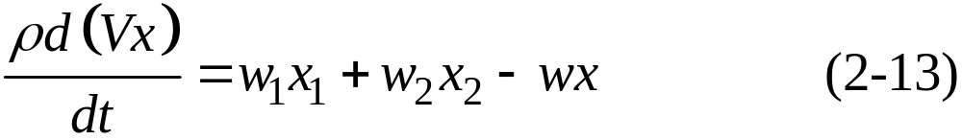
The Blending Process Revisited
For constant , Eqs. 2-2 and 2-3 become:
Chapter 2

Slide 8
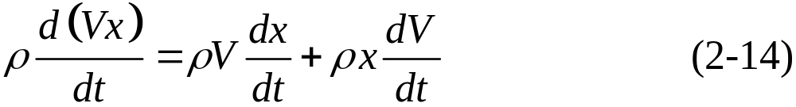
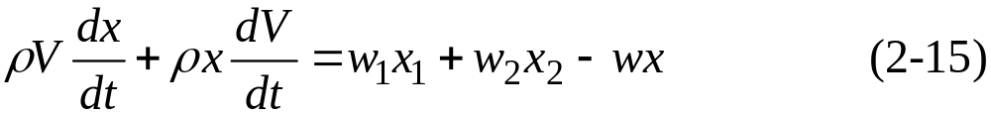

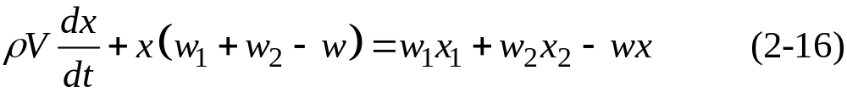
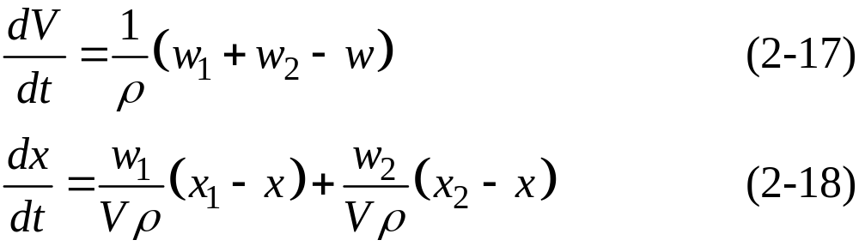
Equation 2-13 can be simplified by expanding the accumulation term using the “chain rule” for differentiation of a product:
Substitution of (2-14) into (2-13) gives:
Chapter 2
Substitution of the mass balance in (2-12) for in (2-15) gives:
After canceling common terms and rearranging (2-12) and (2-16), a more convenient model form is obtained:

Slide 9
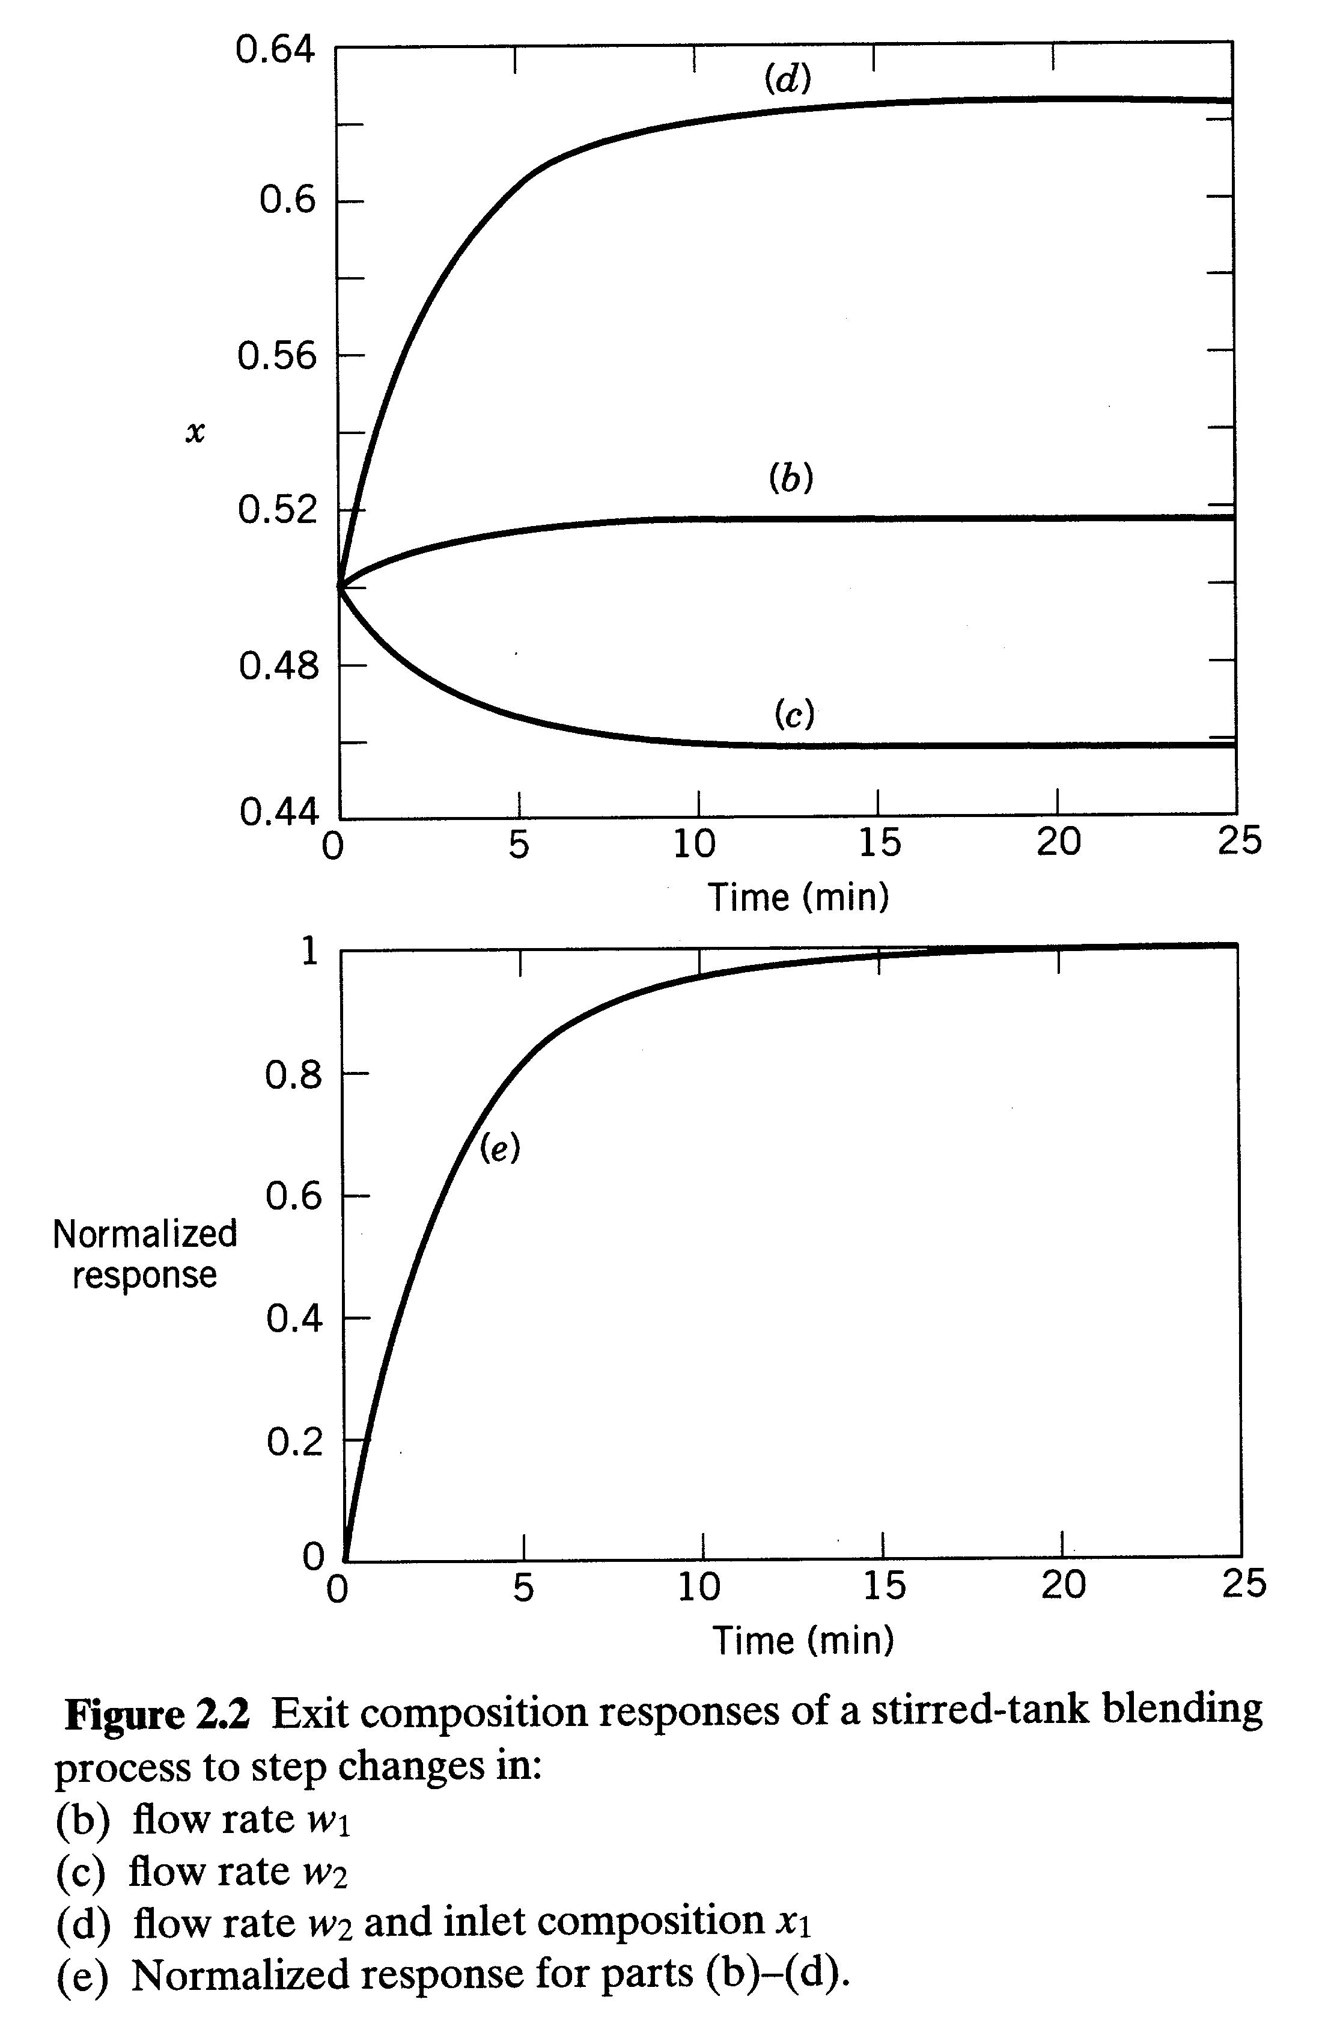
Chapter 2

Slide 10
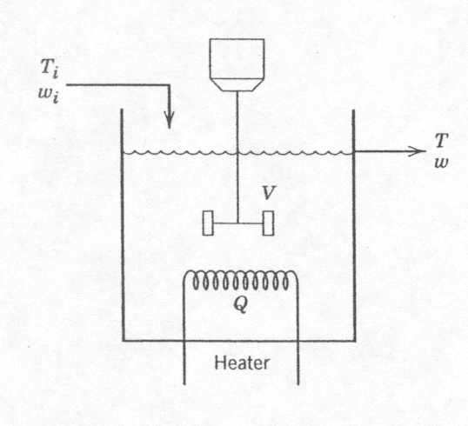
Stirred-Tank Heating Process
Chapter 2
Figure 2.3 Stirred-tank heating process with constant holdup, V.

Slide 11
Stirred-Tank Heating Process (cont’d.)
Assumptions:
Perfect mixing; thus, the exit temperature T is also the temperature of the tank contents.
The liquid holdup V is constant because the inlet and outlet flow rates are equal.
The density and heat capacity C of the liquid are assumed to be constant. Thus, their temperature dependence is neglected.
Heat losses are negligible.
Chapter 2

Slide 12
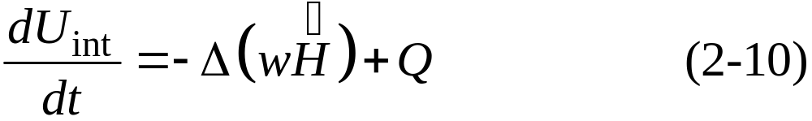
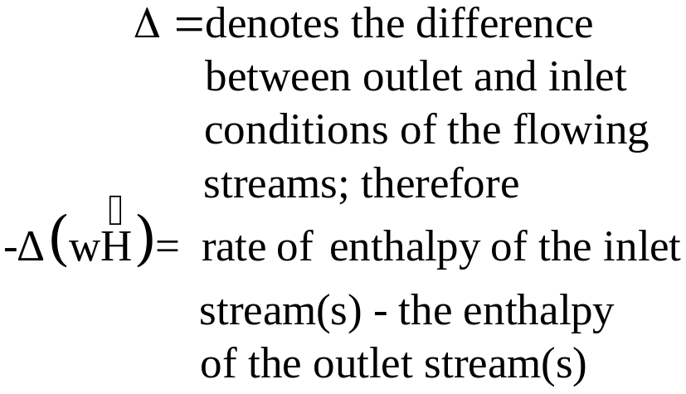
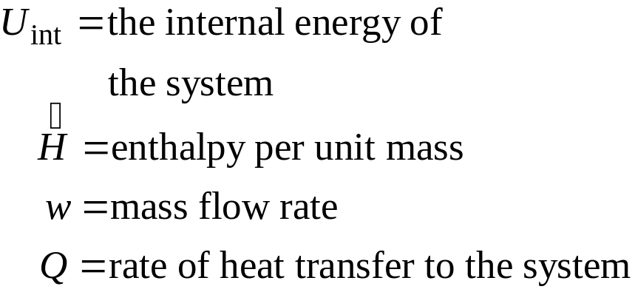
For the processes and examples considered in this book, it
is appropriate to make two assumptions:
Changes in potential energy and kinetic energy can be neglected because they are small in comparison with changes in internal energy.
The net rate of work can be neglected because it is small compared to the rates of heat transfer and convection.
For these reasonable assumptions, the energy balance in
Eq. 2-8 can be written as
Chapter 2

Slide 13



Model Development - I
For a pure liquid at low or moderate pressures, the internal energy is approximately equal to the enthalpy, U_{int} , and H depends only on temperature. Consequently, in the subsequent development, we assume that U_{int} = H and where the caret (^) means per unit mass. As shown in Appendix B, a differential change in temperature, dT, produces a corresponding change in the internal energy per unit mass,
Chapter 2
where C is the constant pressure heat capacity (assumed to be constant). The total internal energy of the liquid in the tank is:

Slide 14
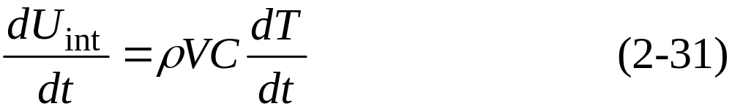

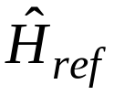
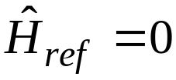
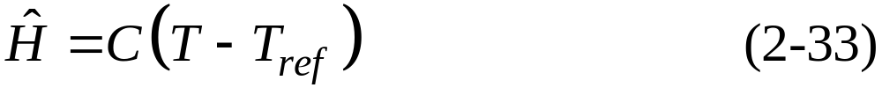
Model Development - II
An expression for the rate of internal energy accumulation can be derived from Eqs. (2-29) and (2-30):
Note that this term appears in the general energy balance of Eq. 2-10.
Chapter 2
Suppose that the liquid in the tank is at a temperature T and has an enthalpy, . Integrating Eq. 2-29 from a reference temperature T_{ref} to T gives,
where is the value of at T_{ref}. Without loss of generality, we assume that (see Appendix B). Thus, (2-32) can be written as:

Slide 15
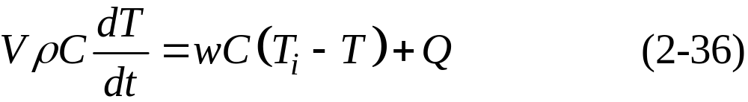
Model Development - III
For the inlet stream
Substituting (2-33) and (2-34) into the convection term of (2-10) gives:
Chapter 2
Finally, substitution of (2-31) and (2-35) into (2-10)

Slide 16
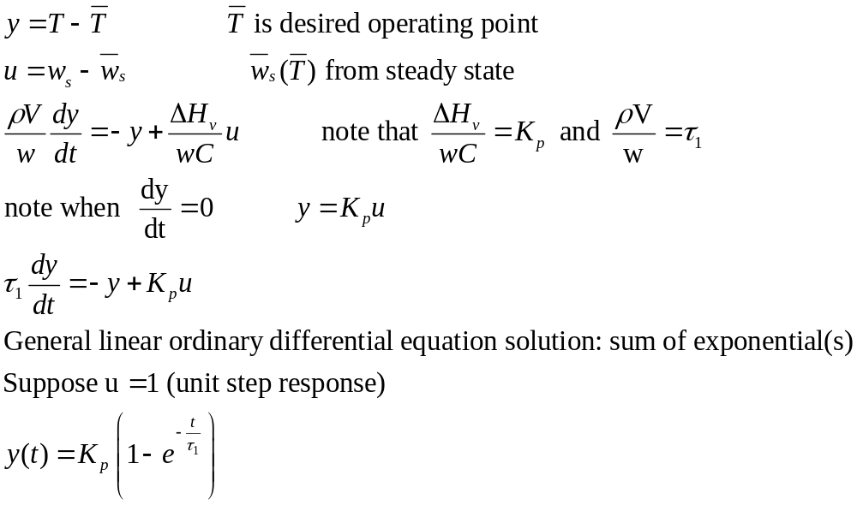
Define deviation variables (from set point)
Chapter 2

Slide 17
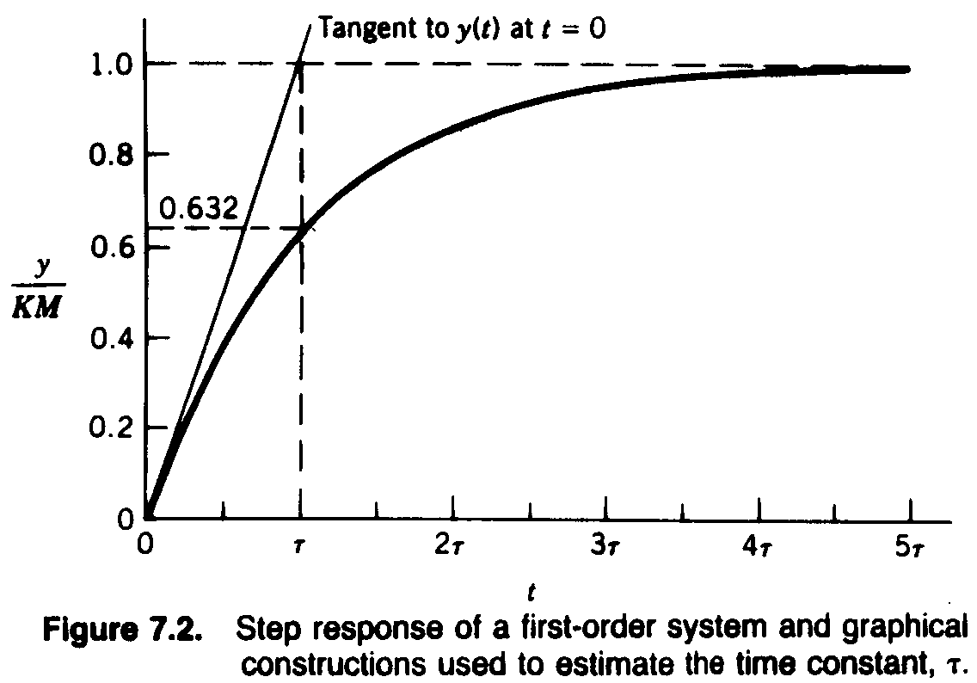
Chapter 2

Slide 18
Table 2.2. Degrees of Freedom Analysis
List all quantities in the model that are known constants (or parameters that can be specified) on the basis of equipment dimensions, known physical properties, etc.
Determine the number of equations N_{E} and the number of process variables, N_{V}. Note that time t is not considered to be a process variable because it is neither a process input nor a process output.
Calculate the number of degrees of freedom, N_{F} = N_{V} - N_{E}.
Identify the N_{E} output variables that will be obtained by solving the process model.
Identify the N_{F} input variables that must be specified as either disturbance variables or manipulated variables, in order to utilize the N_{F} degrees of freedom.
Chapter 2

Slide 19


Degrees of Freedom Analysis for the Stirred-Tank Model:
3 parameters:
4 variables:
1 equation: Eq. 2-36
Thus the degrees of freedom are N_{F} = 4 – 1 = 3. The process variables are classified as:
Chapter 2
1 output variable: T
3 input variables: T_{i}, w, Q
For temperature control purposes, it is reasonable to classify the three inputs as:
2 disturbance variables: T_{i}, w
1 manipulated variable: Q

Slide 20
Degrees of Freedom Analysis for the Stirred-Tank Model:
3 parameters:
4 variables:
1 equation: Eq. 2-36
Thus the degrees of freedom are N_{F} = 4 – 1 = 3. The process variables are classified as:
1 output variable: T
3 input variables: T_{i}, w, Q
For temperature control purposes, it is reasonable to classify the three inputs as:
2 disturbance variables: T_{i}, w
1 manipulated variable: Q

